Slide 1
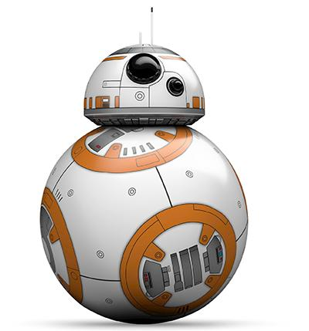
Robot Path Planning - “An Open Ended Problem In Robotics”
START POINT

Slide 2
Presentation Outline
Robotics’ perspective
Path planning(Objective, definitions, terminology, components)
Path vs. Trajectory (Mathematics)
Factors affecting the path planning.
Different approaches to path planning (Algorithms)
Machine learning and AI perspective
Role of AI in robotic path planning
Various approaches (RL, GAN, LSTM)
Some relevant papers and recent research
Datasets

Slide 3
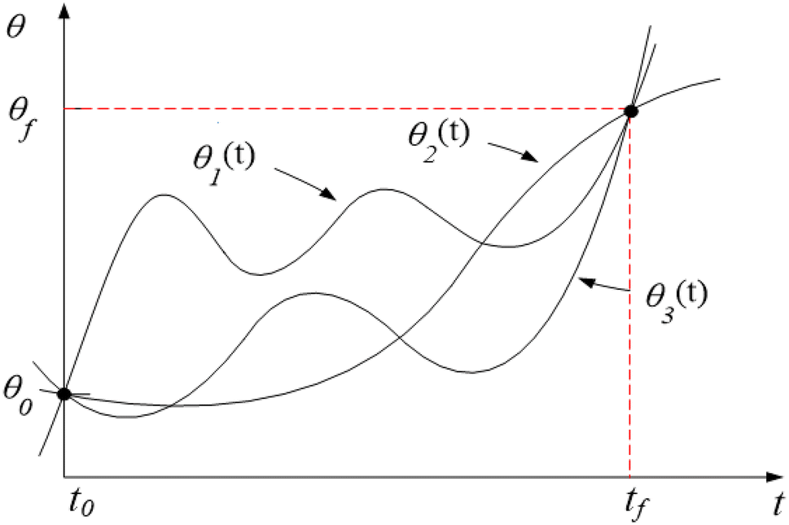
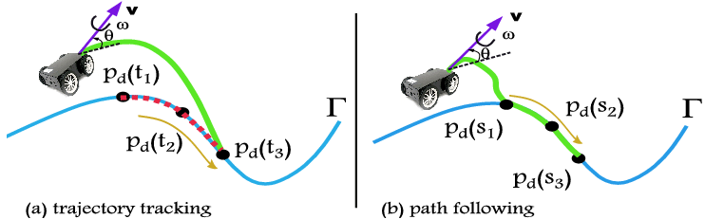
What is Path?
A path will refer to the complete route traced from the start to the goal end point. The path is made up of a number of segments and each of these path segments is continuous (no stop points).
Trajectory planning is moving from point A to point B while avoiding collisions over time. This can be computed in both discrete and continuous methods.

Slide 4
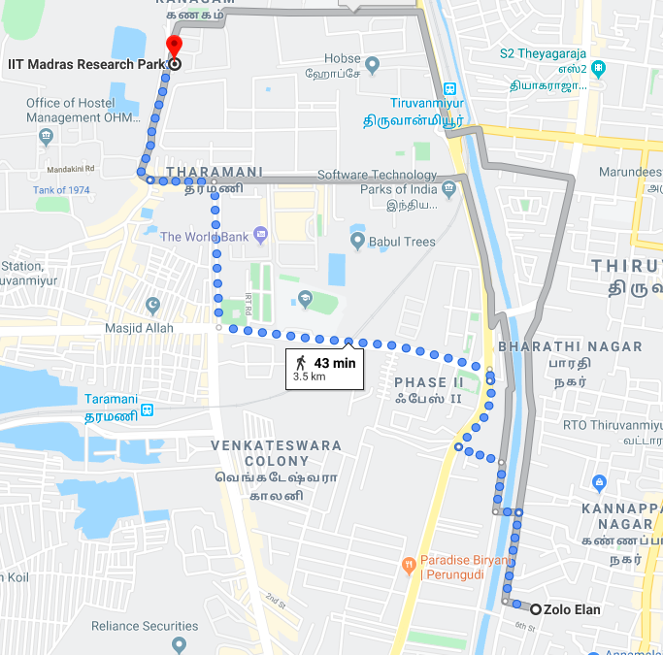
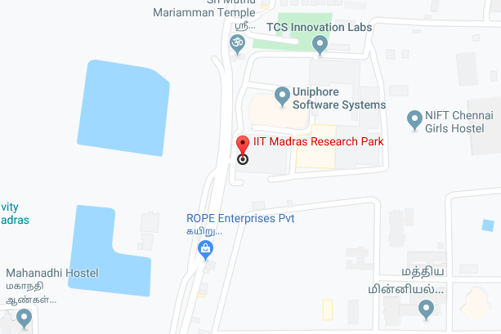
Components of path planning
Localisation - It helps the robot to determine its location in the environment with the help of :
Ultrasound sensors, laser rangefinders etc.
Location can be used as a symbolic reference to the local environment.
Mapping - it helps to identify the direction and the orientation (latitude, longitude and altitude)
The map is placed into robot’s emory in graphical or matrix form.

Slide 5
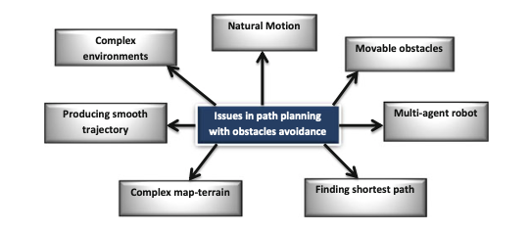
Issues in path planning

Slide 6
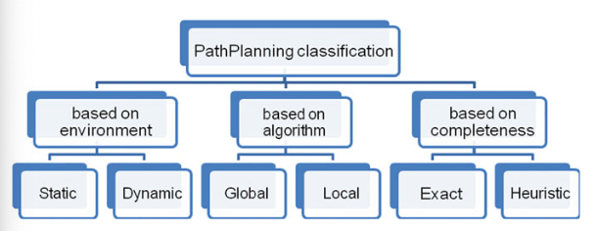
Categories of path planning

Slide 7
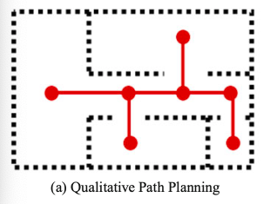
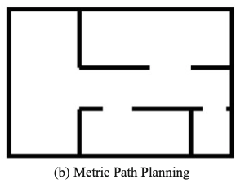
Spatial Representations Commonly Used in Path Planning

Slide 8
Environment Characterisation
The path planning problem can be done in both static and dynamic environments.
Structured environment: in which obstacles have a structured shape and nicely placed within the map. In such a case, the robotic map can easily specify the way the robot can move avoiding obstacles. and obstacles are represented approximately by fitting into the cells.
Unstructured environment or semi-structured: Real robot environments are usually unstructured in which obstacles may have different shape and sizes and be placed in inclined orientation. The algorithm needs to compute a feasible and an optimal path. James Kuffner proposed a real-time path planning of autonomous vehicles for unstructured road navigation.

Slide 9
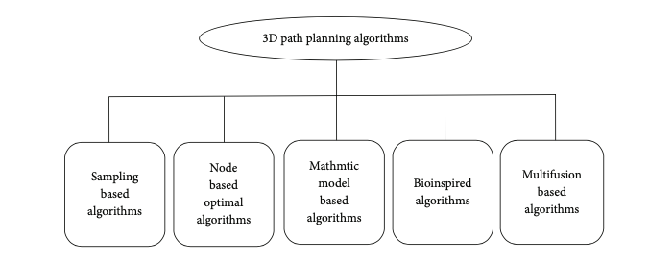
Path Planning Taxonomy

Slide 10
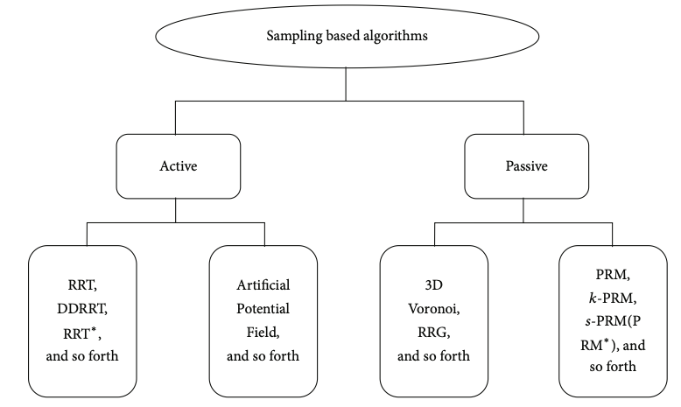
Sampling Based Algorithms
Elements & Analysis
Needs preknown data about the workspace (i.e the mathematics related two the workspace)
Random sampling and Gaussian sampling are prominently used.

Slide 11
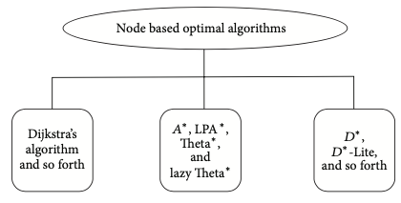
Elements of the node based algorithms
Node based optimal algorithms are classified by the reason that they deal with nodes’ and arcs’ weight information (but not limited to these, or sometimes called grid).
Also known as network algorithms they calculate the cost on the basis of the node exploration.

Slide 12
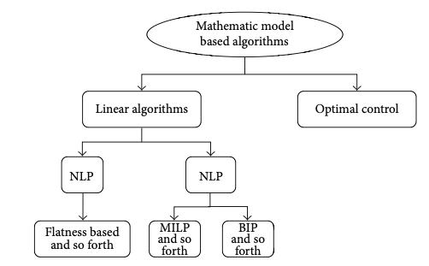
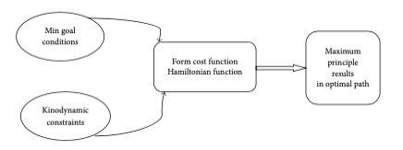
Mathematical model based algorithms
Mathematics model based algorithms optimize by describing kinodynamic constraints in combination of polynomial forms.
They can model the environment as a time variant system (sometimes even a model and time variant system), which is synchronization to the current location of the robot.
Optimization Steps

Slide 13
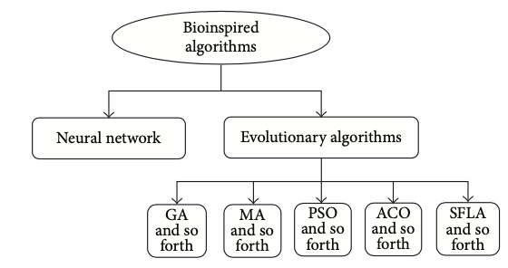
Bio- inspired algorithms
Bioinspired algorithms originate from mimicking biological behavior to solve problems.
Genetic Algorithm (GA), Memetic Algorithm (MA), Particle Swarm Optimization (PSO), Ant Colony Optimization (ACO), and Shuffled Frog Leaping Algorithm (SFLA).

Slide 14
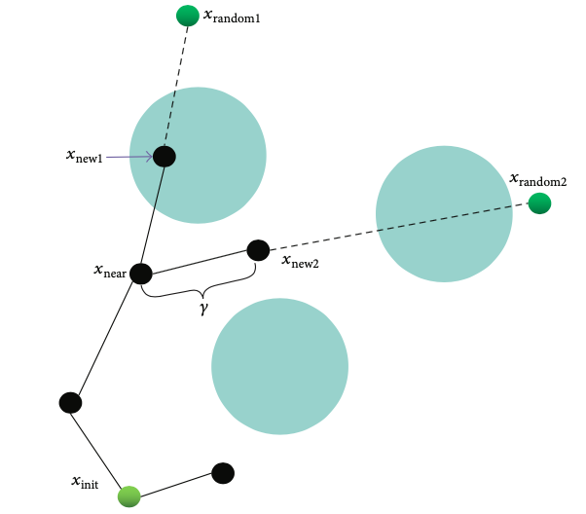
RRT(Rapidly-exploring random tree)
Proposed by Steve M LaValle for robotic path planning.
Based on Resolute completeness, the algorithm will return an optimal solution if one exists.
It searches the configuration space to generate a path connecting the start and the end node.
The configuration space consists of two parts, a fixed obstacle region, 𝑋obs ⊂ 𝑋, which must be avoided, and an obstacle free region, 𝑋free ⊂ 𝑋, where the robots must stay. Corresponding to the configuration space, a path state (or vertex) set 𝑃 includes all the sampling vertices which are generated by RRT exploration process. RRT 2D, RRT 3D

Slide 15
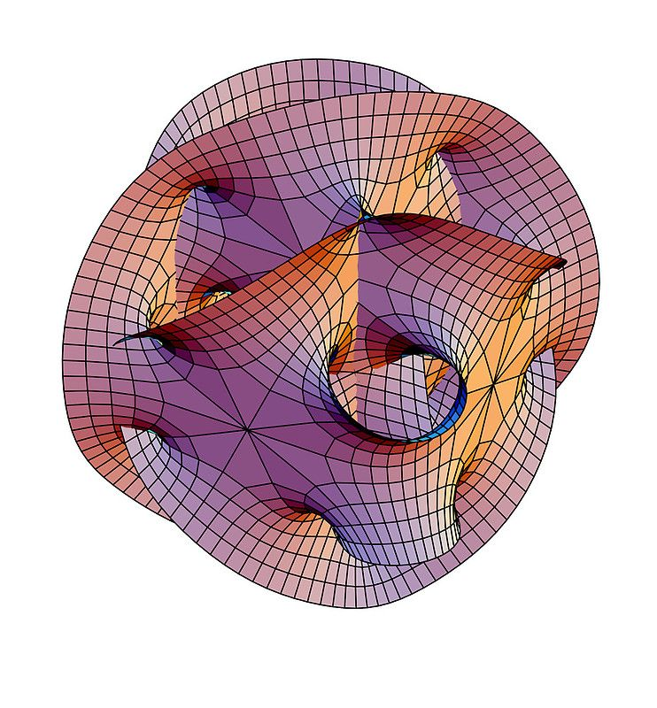
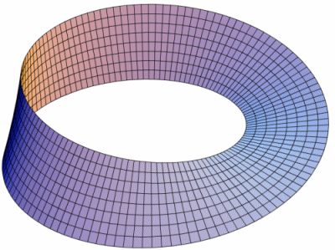
RRT Components
State Space - A topological space, denoted by X.
Boundary values - x_{init} ε X and x_{free} ⊂ X
Collision detector - A function, D : X - {true, false} that determines the presence of obstruction in the space.

Slide 16
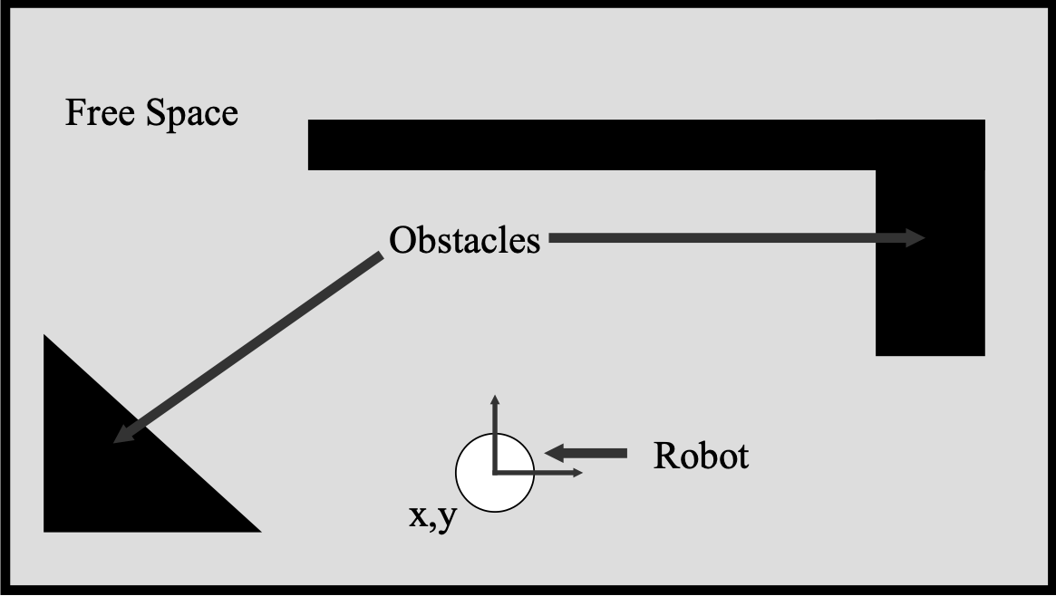
What is world?

Slide 17
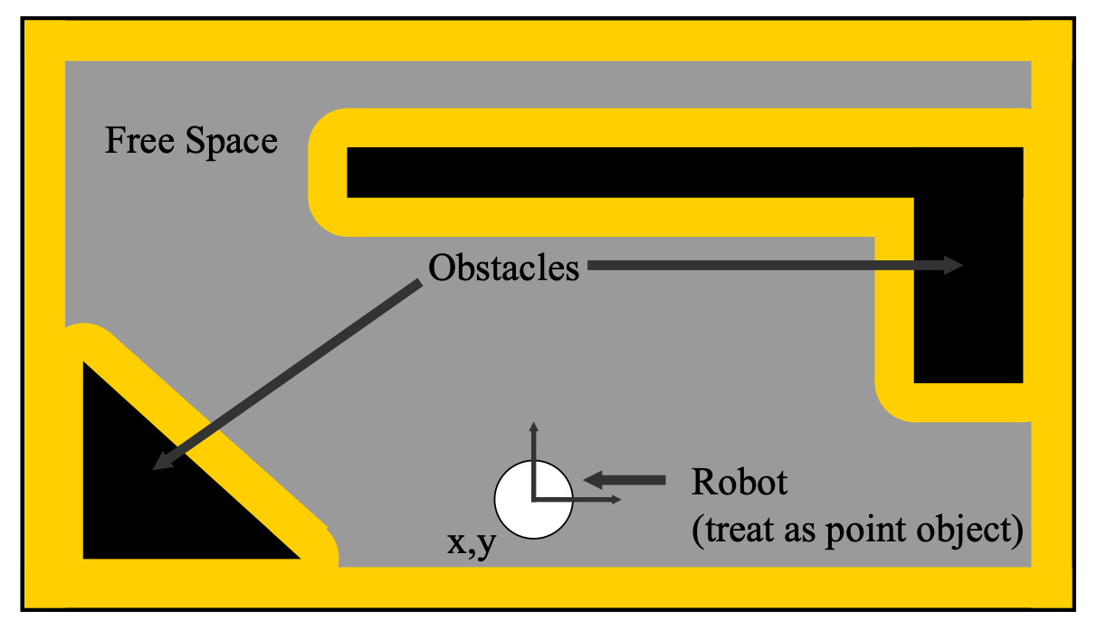

Slide 18
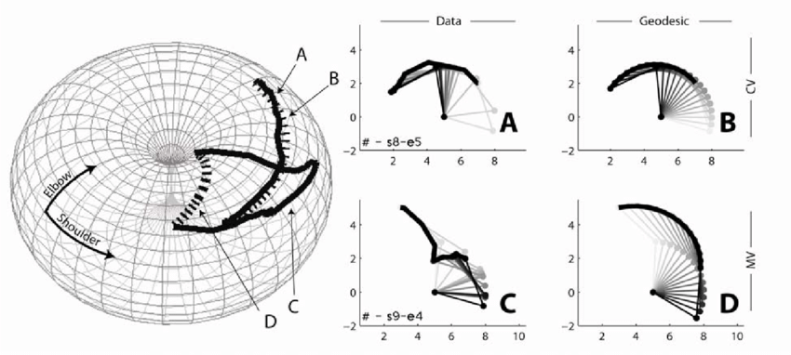
Configuration space vs the Workspace

Slide 19
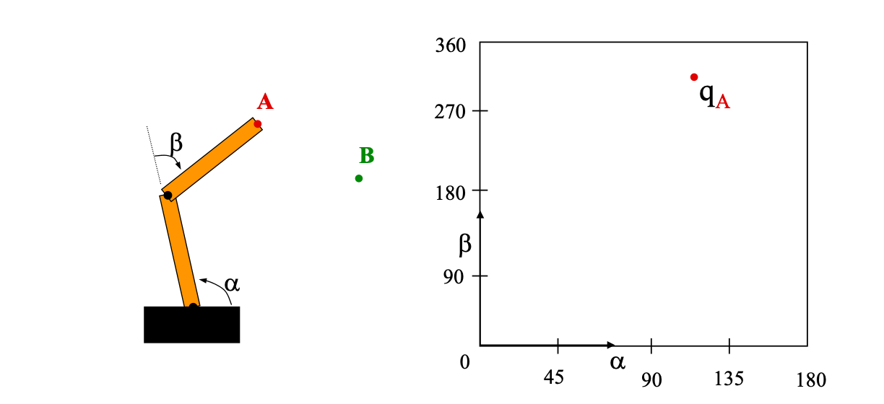
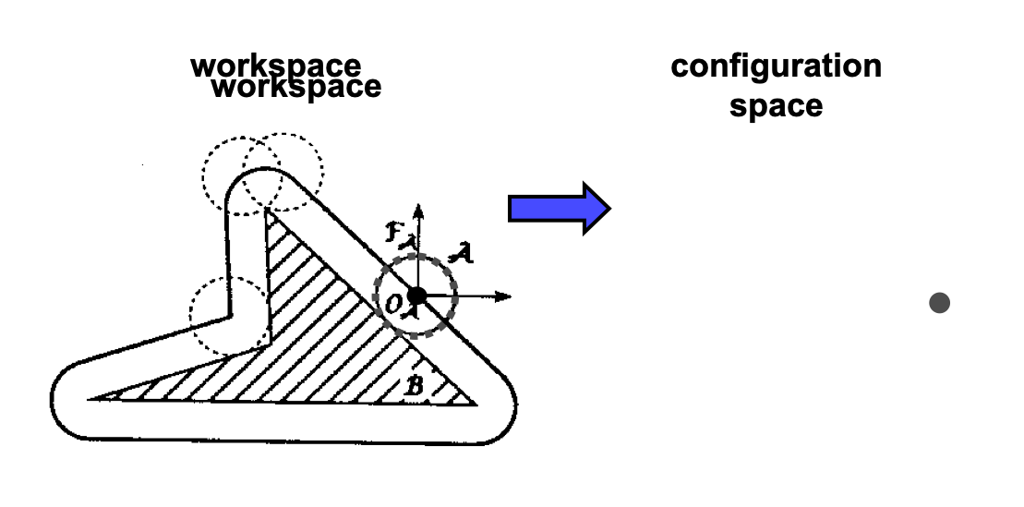
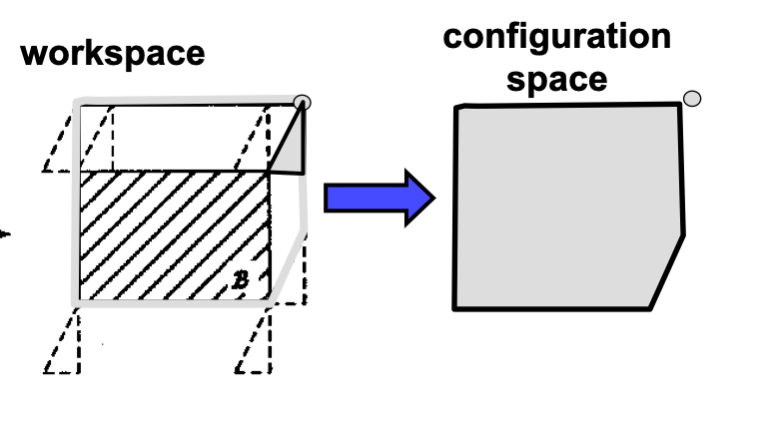

Slide 20
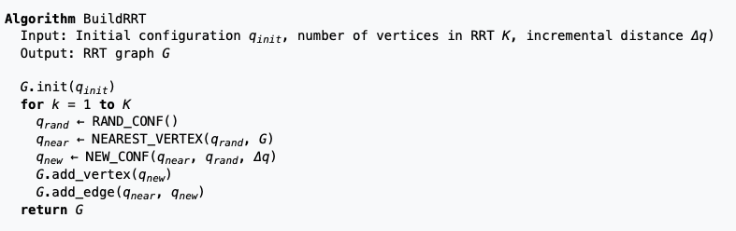
RRT Implementation

Slide 21
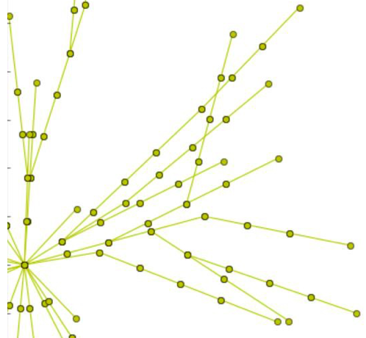
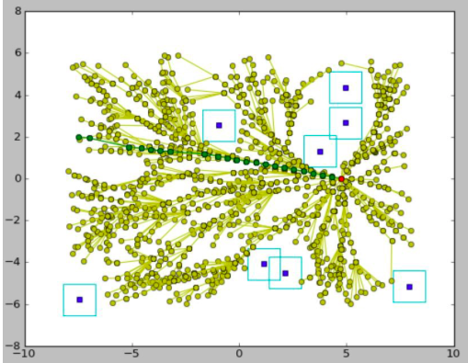
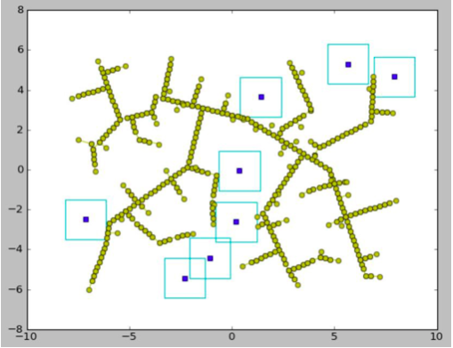
RRT vs RRT*
The benefit of the algorithm is its speed and implementation. Compared to other path planning algorithms, RRT is fairly quick. The costliest part of the algorithm is finding its closest neighbor as this process grows depending on the number of vertices that have been generated.

Slide 22
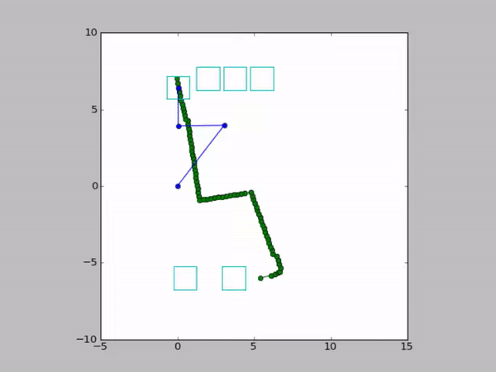
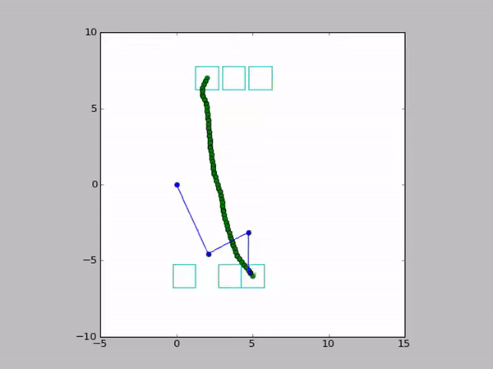
RRT* creates incredibly straight paths.
If the destination were to change, the original graph can still be used as it represents the quickest path to most locations in the region.

Slide 23
What if we explore a larger space?
The RRT algorithm was advantageous to find possible paths from a given point. Yet, each time a new location was given, an entirely new graph had to be generated.
Repeatedly generating a new graph to find a single path is arguably inefficient, especially if a relatively large area is being explored.
An alternative approach that addresses this deficiency is the Probabilistic Roadmap (PRM) algorithm.

Slide 24
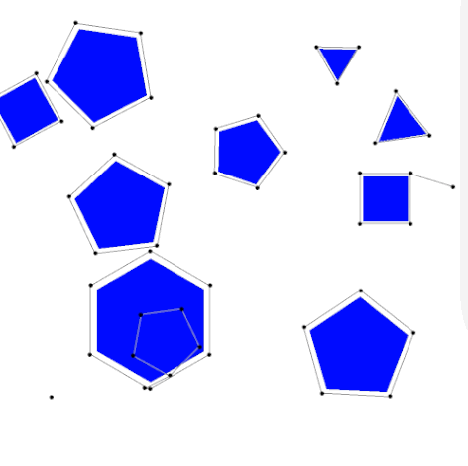
PRM(Probabilistic Roadmap)
PRM planner is a path planning algorithm in the field of robotics.
Based on graph formation principle to determine the path between the starting node and the destination node.
Yields the most feasible configurations present in the free space and connects them to a local path. (analogous to the roads connecting a highways or an expressway)

Slide 25
Implementation
G(V,E) = Null //Initialize a graph as empty
For node in Xnearest:
limit = n //number of nodes to make graph out of
Rad = r //radius of neighborhoods
if not ConnectedComp(Xnew,node) and not Obstacle(Xnew,node):
G(V,E) += {Xnew,node} //add edge and node to graph
Xnew.comp += node.comp//add Xnew to connected component
For itr in 0...limit:
Xnew = RandomPosition()
Xnearest = Near(G(V,E),Xnew,Rad) //find all nodes within a Rad
Xnearest = sort(Xnearest) //sort by increasing distance
Return G(V,E)

Slide 26
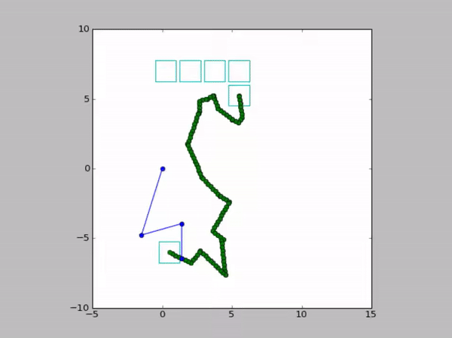
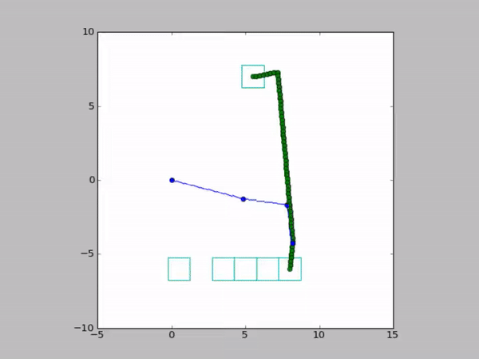
PRM Variants and Comparison
PRM Output
PRM* Output

Slide 27
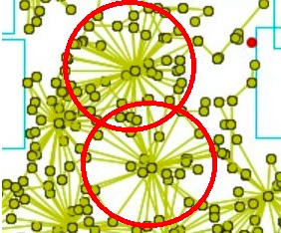
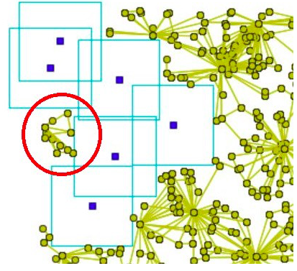
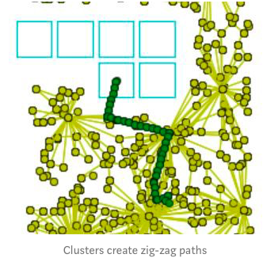
Merits & Demerits
Clustering
Graphs with fixed radius tends to form a sparse roadmap
Experiencing zig-zag paths

Slide 28
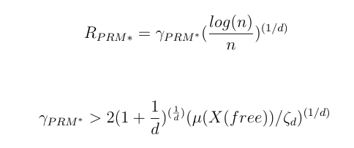
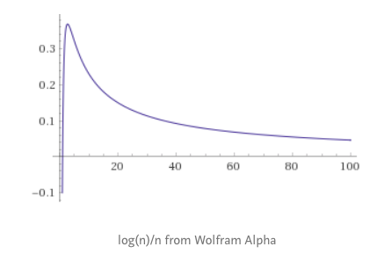
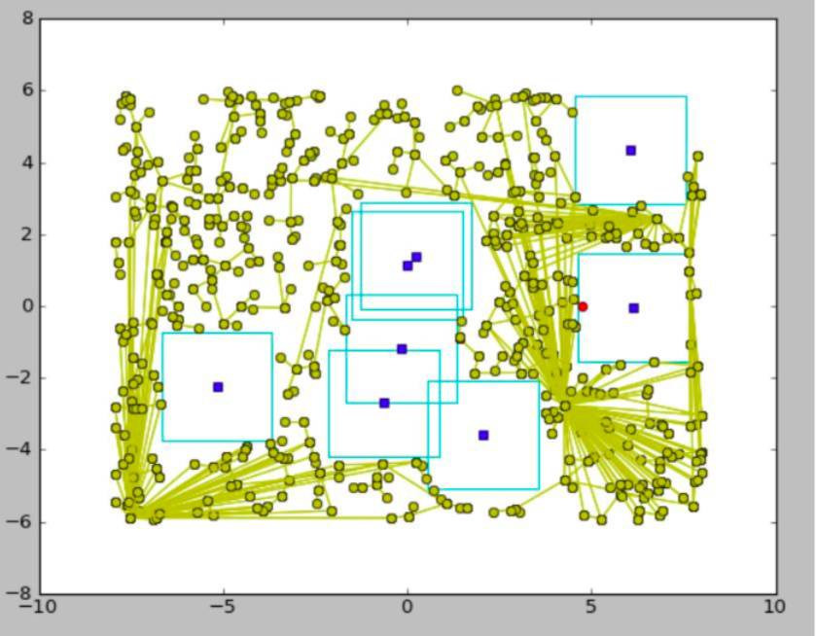
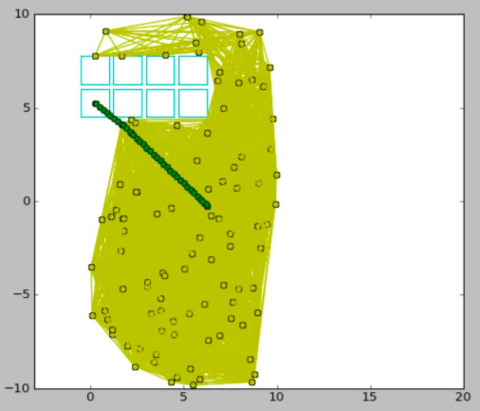
PRM*

Slide 29
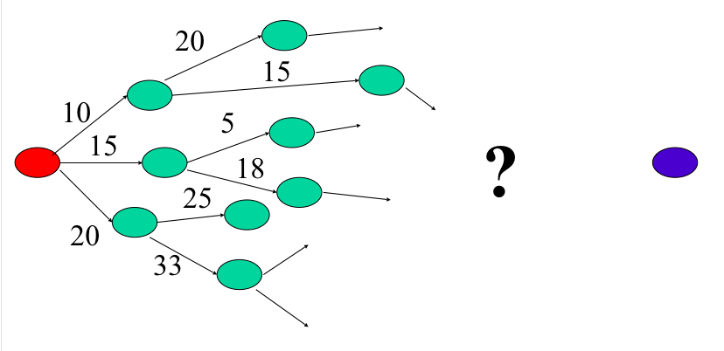
Dijkstra’s algorithm
Greedy algorithm: from the candidate nodes select the one that has a path with minimum cost from the starting node.

Slide 30
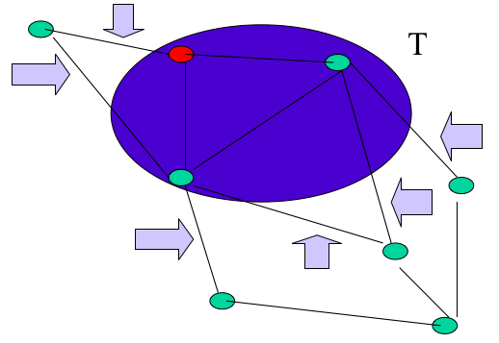
Dijkstra’s algorithm implementation
Given a Graph G = (V,E) and T a subset of V, the fringe of T, is defined as:
Fringe(T) = { (w,x) in E : w ∈ T and x ∈V − T}

Slide 31
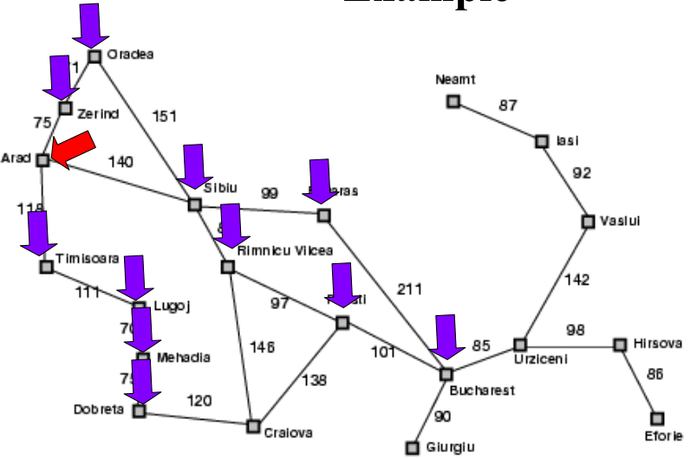
Drawbacks with Dijkstra’s
•Actual complexity is O(|E|log₂ |E|)

Slide 32
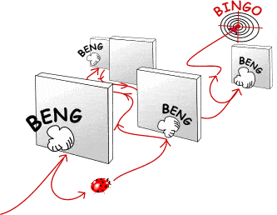
Only one solution - “Make hunches” !!!
Use heuristics to guide the search
Heuristic: estimation or “hunch” of how to search for a solution
We define a heuristic function:
h(n) = “estimate of the cost of the cheapest path from the starting node to the goal node”

Slide 33
A* algorithm
An informed search algorithm based which explores by constructing a weighted graph.
It aims to find a path to a given goal node having smallest cost.
Based on formula f(n) = g(n) + h(n)
Where f(n) is the function for evaluating the total cost,
g(n) is cost of the path from start node to the end node,
h(n) is a heuristic function that estimates the cost for the cheapest path.
The algorithm uses priority queue to perform repeated selection of nodes with least cost.
The path returned by the algorithm is admissible but not consistent.

Slide 34
Some Interesting Properties
Termination and Completeness - On the weighted finite graphs A* guarantees to find a solution if one exists.
Admissibility - A search algorithm is said to be admissible if it is guaranteed to return an optimal solution.
Optimal Efficiency - Optimal efficiency is about the set of nodes expanded, not the number of node expansions (the number of iterations of A*'s main loop).
Bounded Relaxation - Speeding up the search at the expense of optimality puts some relaxation on the admissibility criteria.
S’(n) = (1+ε) S(n)

Slide 35
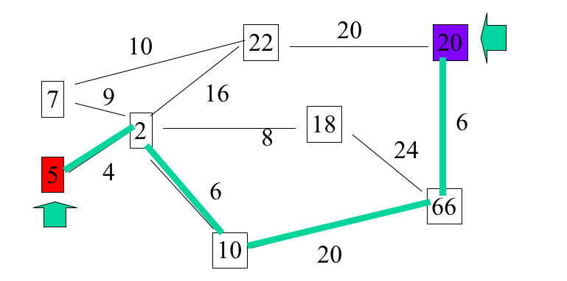

Slide 36
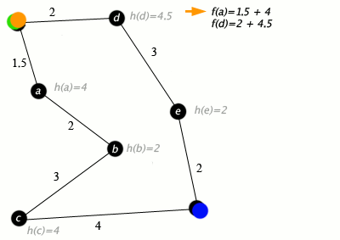
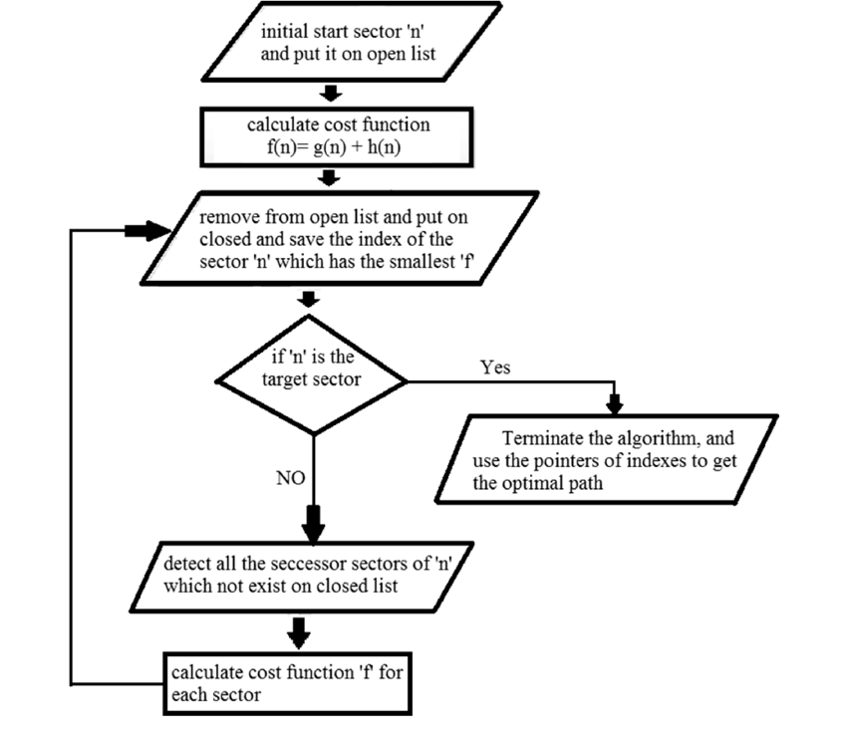
Implementation

Slide 37
Applications & Special Case
Video Games
Used in NLP for parsing stochastic grammars.
Used along with the Dijkstra’s algorithm in dynamic programming.

Slide 38
Merits & Demerits (Time and Space Complexity)
Iterative deepening A*, memory bounded A*, and SMA*.
The space complexity for A* algorithm is roughly same as all other graph search algorithms.
When search space is a tree the time complexity is given by,
|h(x) - h*(x)| = O(logh*(x))
Here, h* is optimal heuristic, the exact cost to get from start node to the goal node.
The time complexity for worst case scenario when the nodes expanded is exponential
Time complexity, T = O(b^{d}), where b is branching factor and d is the depth.

Slide 39
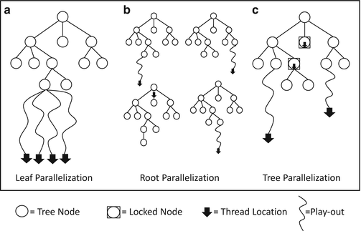
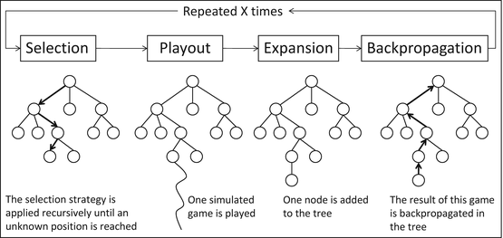
MCTS(Monte Carlo Tree Search)
Probabilistic and Heuristic driven search technique.
Combining the tree construction with principles of reinforcement learning.
Based on Exploration-Exploitation tradeoff.
4 distinct steps selection, expansion, simulation and backpropagation.

Slide 40
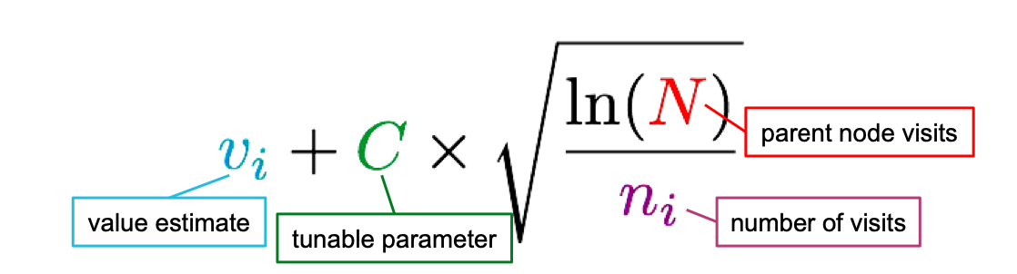
Upper confidence bound (UCB)
Pick each node with probability proportional to:
● probability is decreasing in the number of visits (explore)
● probability is increasing in a node’s value (exploit)
● always tries every option once

Slide 41

MCTS Pseudocode

Slide 42



Examples
MCTS

Slide 43
Merits & Demerits
Merits
Easy Implementation.
Supports asymmetric tree expansion in any direction.
Setting manual checkpoints is possible for later rollback.
Operates effectively without any prior knowledge and has tendency to master its moves by random playouts.
Demerits
A memory exhaustive algorithm.(consumes large amount of memory)
Less reliable in turn-based games with vast amount of combination.
Execution time is more.

Slide 44

Let’s delve into AI
Assembly - AI is a highly useful tool in robotic assembly applications. When combined with advanced vision systems, AI can help with real-time course correction, which is particularly useful in complex manufacturing sectors like aerospace.
Packaging - Robotic packaging uses forms of AI frequently for quicker, lower cost and more accurate packaging.
Customer service - Robots are now being used in a customer service capacity in retail stores and hotels around the world.
Open source robotics - A handful of robotic systems are now being sold as open source systems with AI capability.

Slide 45




Examples

Slide 46


Machine learning at glance
Generative adversarial networks…. [paper]
Reinforcement Learning….[paper 1] [paper 2]
Behaviour Tree [paper]
bioshock
Halo 5

Slide 47
Some useful datasets
End Point
Barcelona Robot lab dataset
Awesome Robotics datasets
Occupancy Map dataset
MIT stata Center dataset
UCI dataset

Slide 48
Thank You Humans !!!

